Slide 1

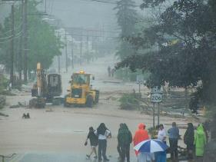
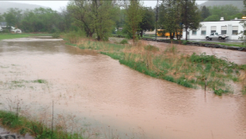
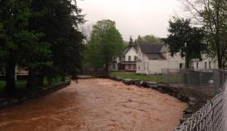
                Local Flood Analysis
                Summary Meeting
                West Branch Tributaries
Walton Flood Commission and
Village and Town of Walton
David Murphy, P.E., CFM
Delaware County Soil & Water Conservation District | December 14, 2017

Slide 2

Agenda
East Brook
West Brook
Third Brook
Recommended Actions

Slide 3
Agenda
East Brook
West Brook
Third Brook
Recommended Actions

Slide 4
Existing Conditions along East Brook

Slide 5
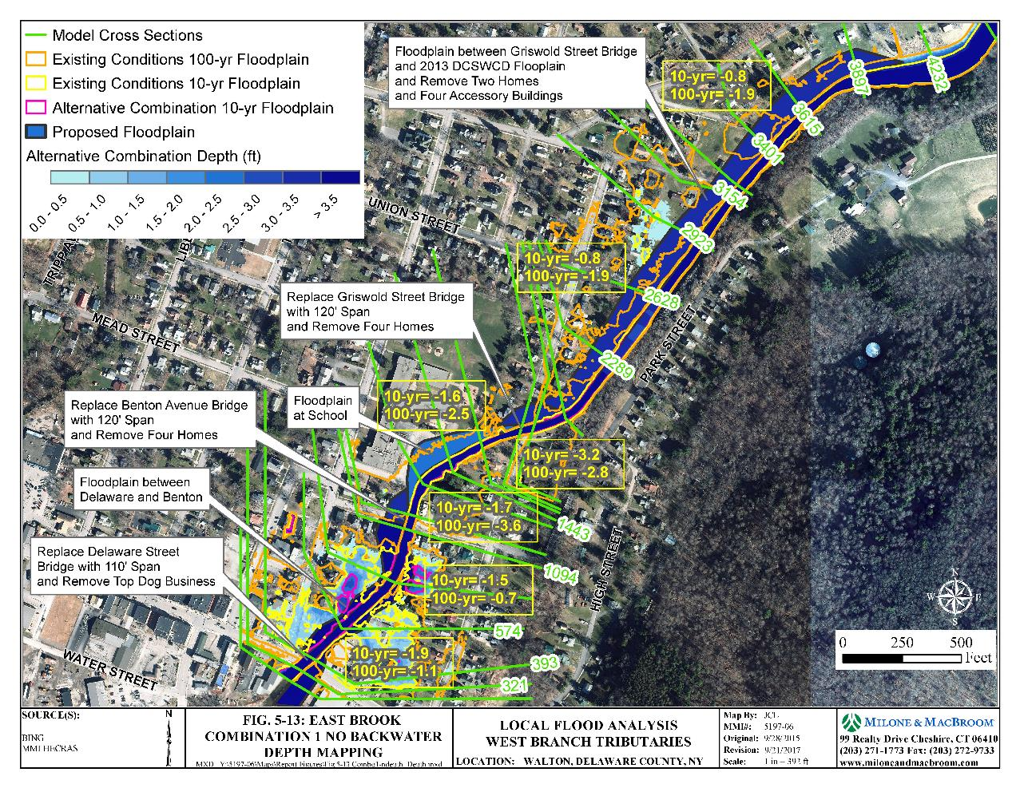
Combination of Options along East Brook

Slide 6
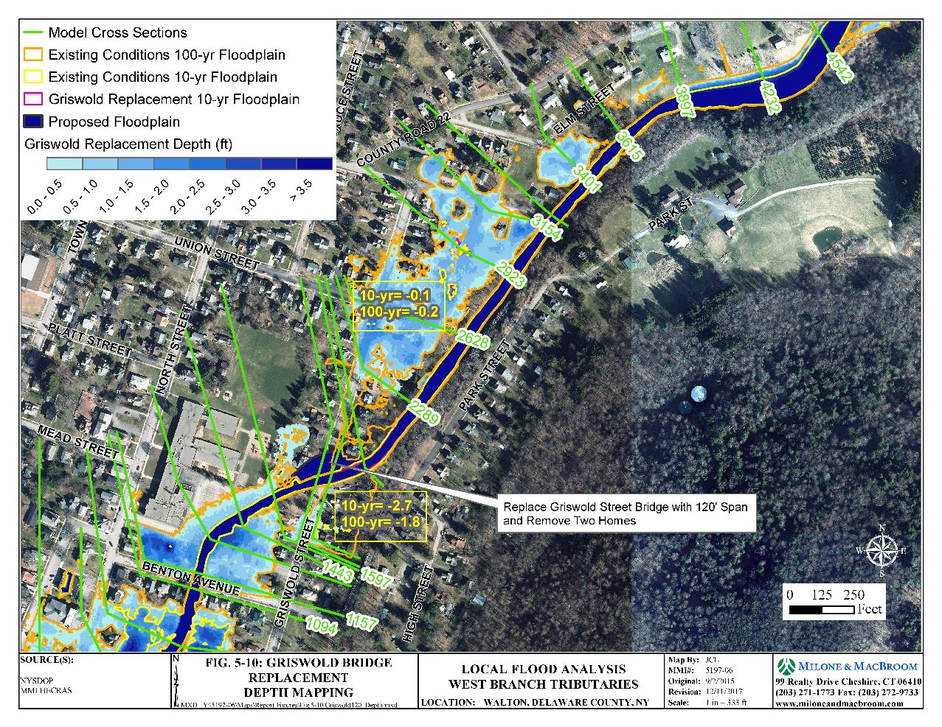
Focus Above Griswold Street Bridge

Slide 7
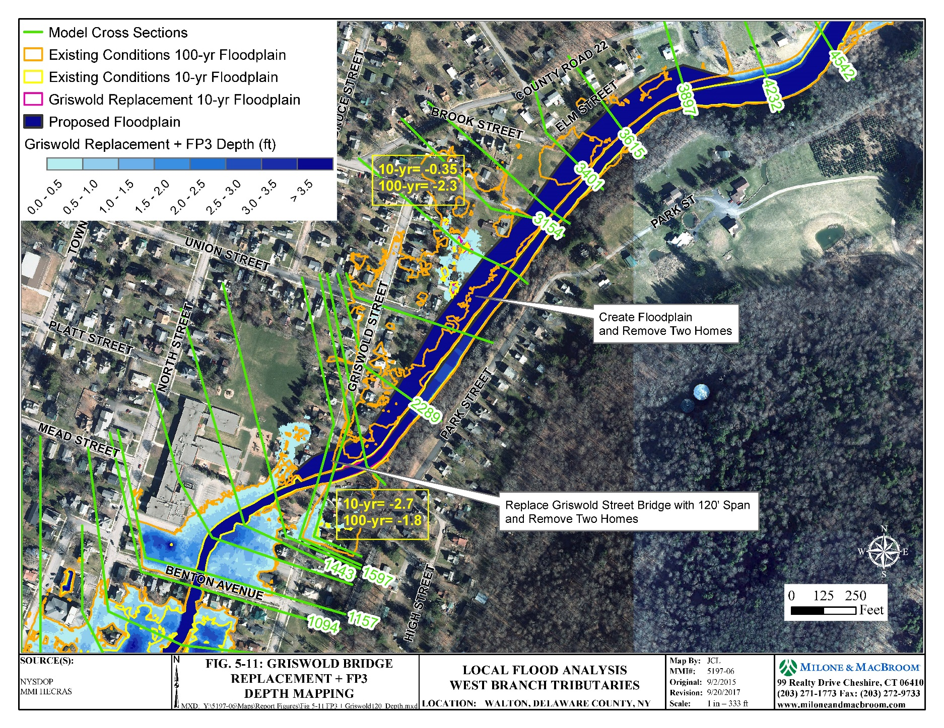
Focus Above Griswold Street Bridge

Slide 8
Total Benefits (Ranges) along East Brook
1.7-2.5M
0.5-1.1M
0.8-1.2M

Slide 9
Agenda
East Brook
West Brook
Third Brook
Recommended Actions

Slide 10
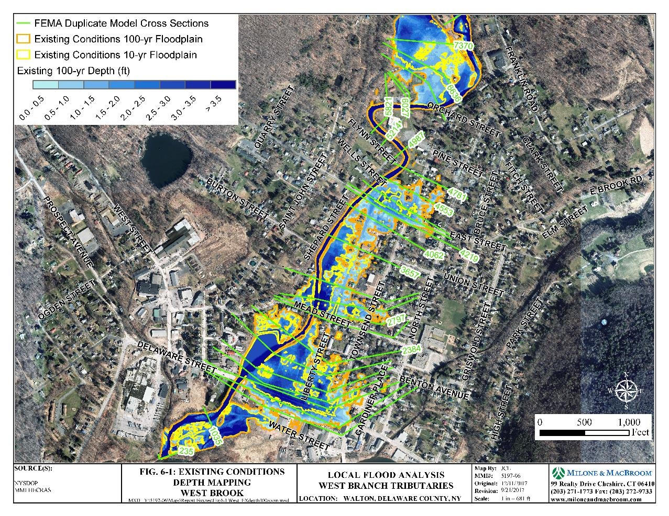
Existing Conditions along West Brook

Slide 11
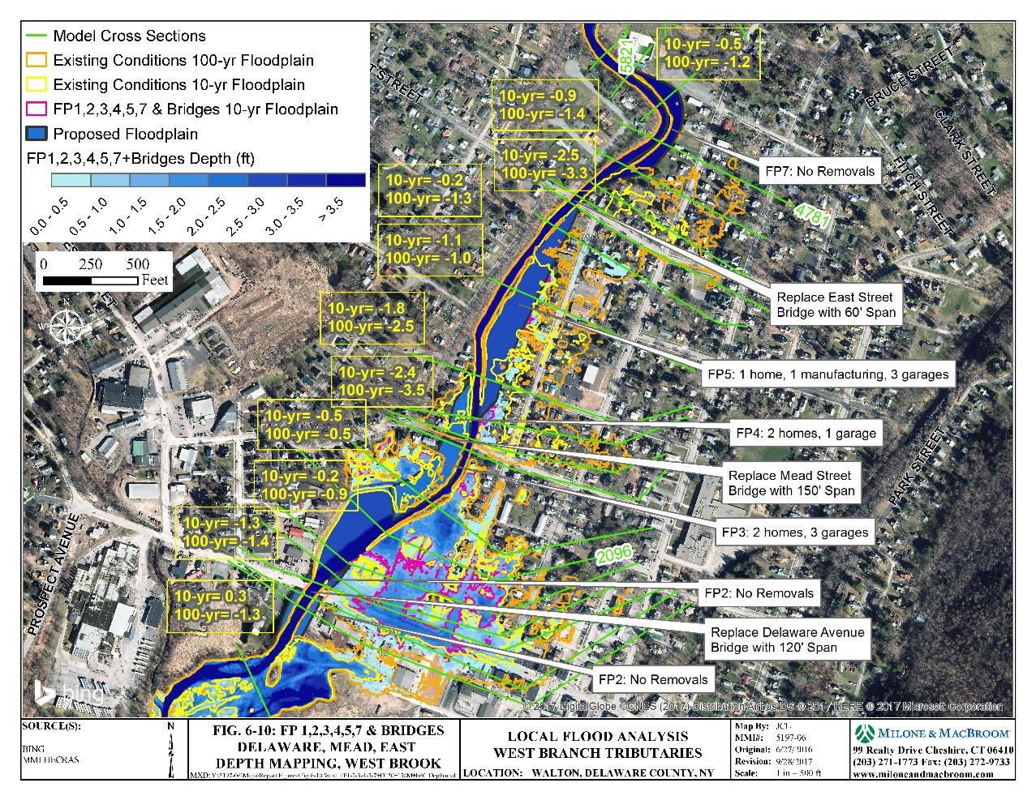
Combination of Options along West Brook

Slide 12
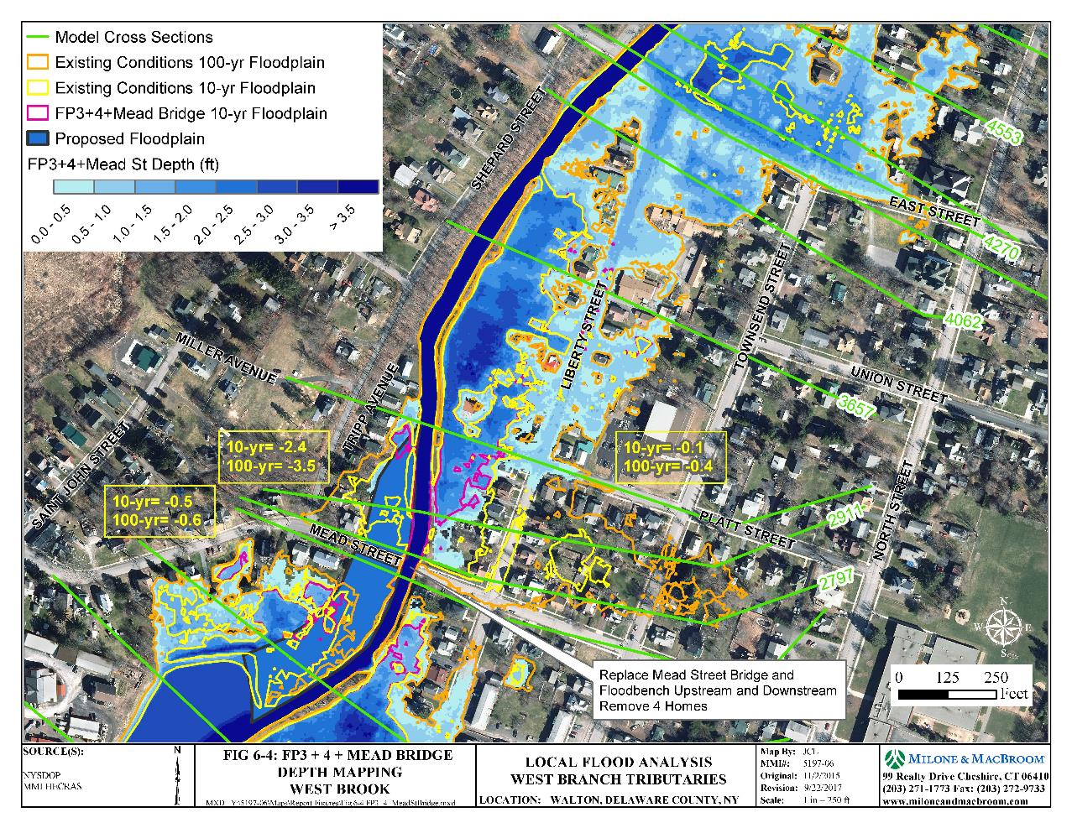
Focus Above Mead Street Bridge

Slide 13
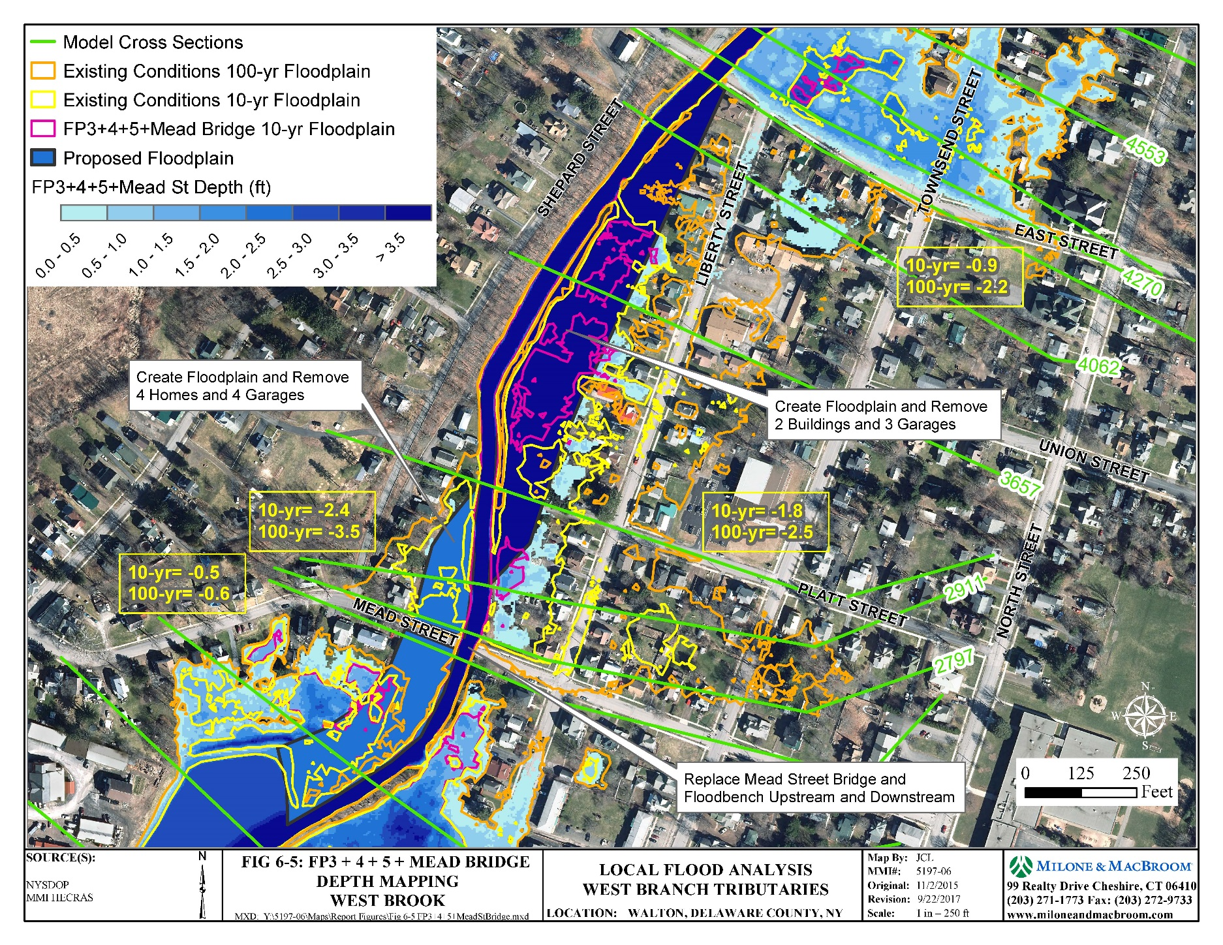
Focus Above Mead Street Bridge

Slide 14
Total Benefits (Ranges) along West Brook
0.6M
1.5-2.1M
3.1-4.1M

Slide 15
Agenda
East Brook
West Brook
Third Brook
Recommended Actions

Slide 16
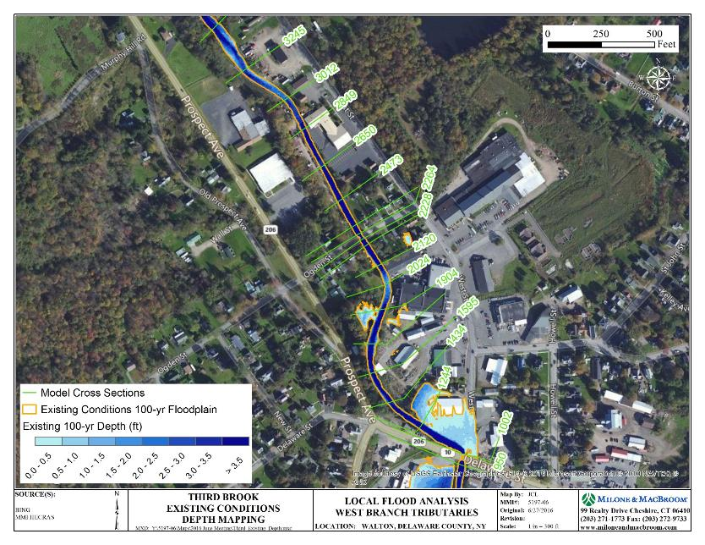
Third Brook Existing Depth Map

Slide 17
Third Brook Floodplain Restorations

Slide 18
Focus Along Lower Third Brook Road

Slide 19
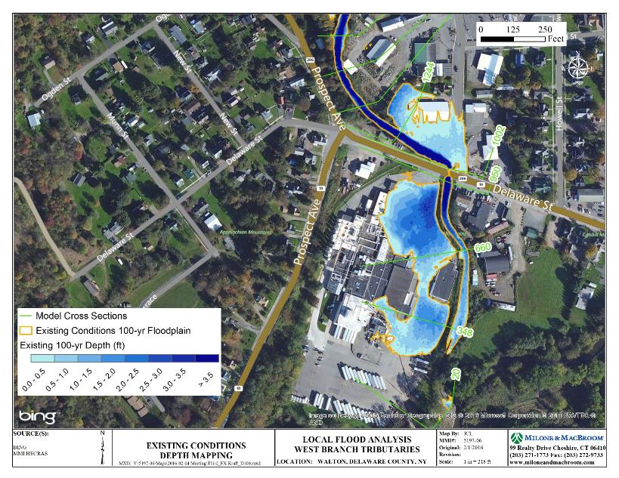
Focus on Kraft

Slide 20
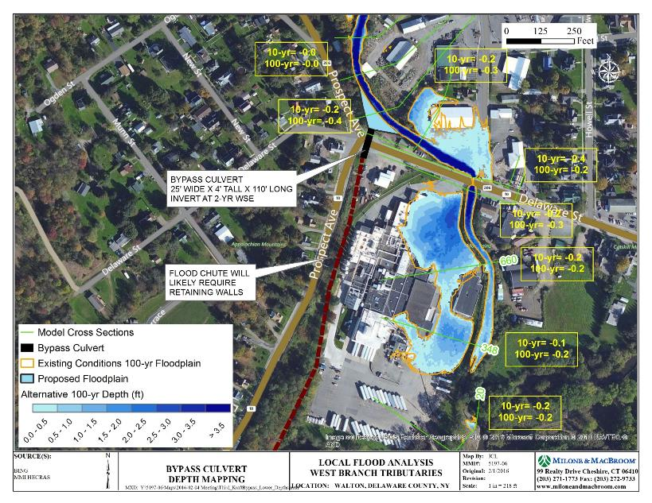
Test of Bypass Culvert at Kraft

Slide 21
Agenda
East Brook
West Brook
Third Brook
Recommended Actions

Slide 22
Recommended Actions
Proceed with implementation of West Brook Alternatives 1 or 2 as funding allows
Study the feasibility of East Brook Alternative 7 including the viability of not maintaining a crossing of the brook at Benton Avenue
Future bridge replacements must incorporate larger openings to reduce flooding
Pursue floodproofing of commercial buildings
Pursue elevation of homes on a case-by-case basis as property owners ask
When opportunities arise for acquisitions where floodplain projects may be effective in the future, support these acquisitions
Re-instate the gauging station on East Brook
Consider establishing some type of gauging station on West Brook

Slide 24
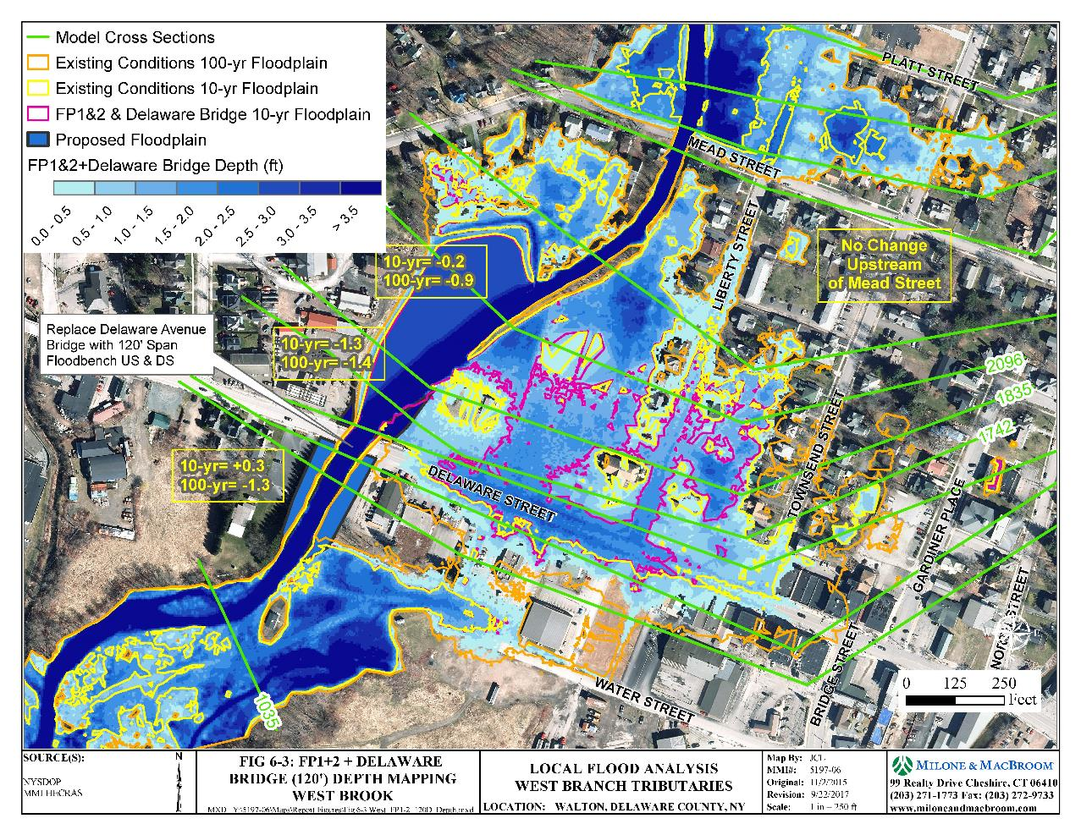
Focus Above Delaware Street Bridge

Slide 25
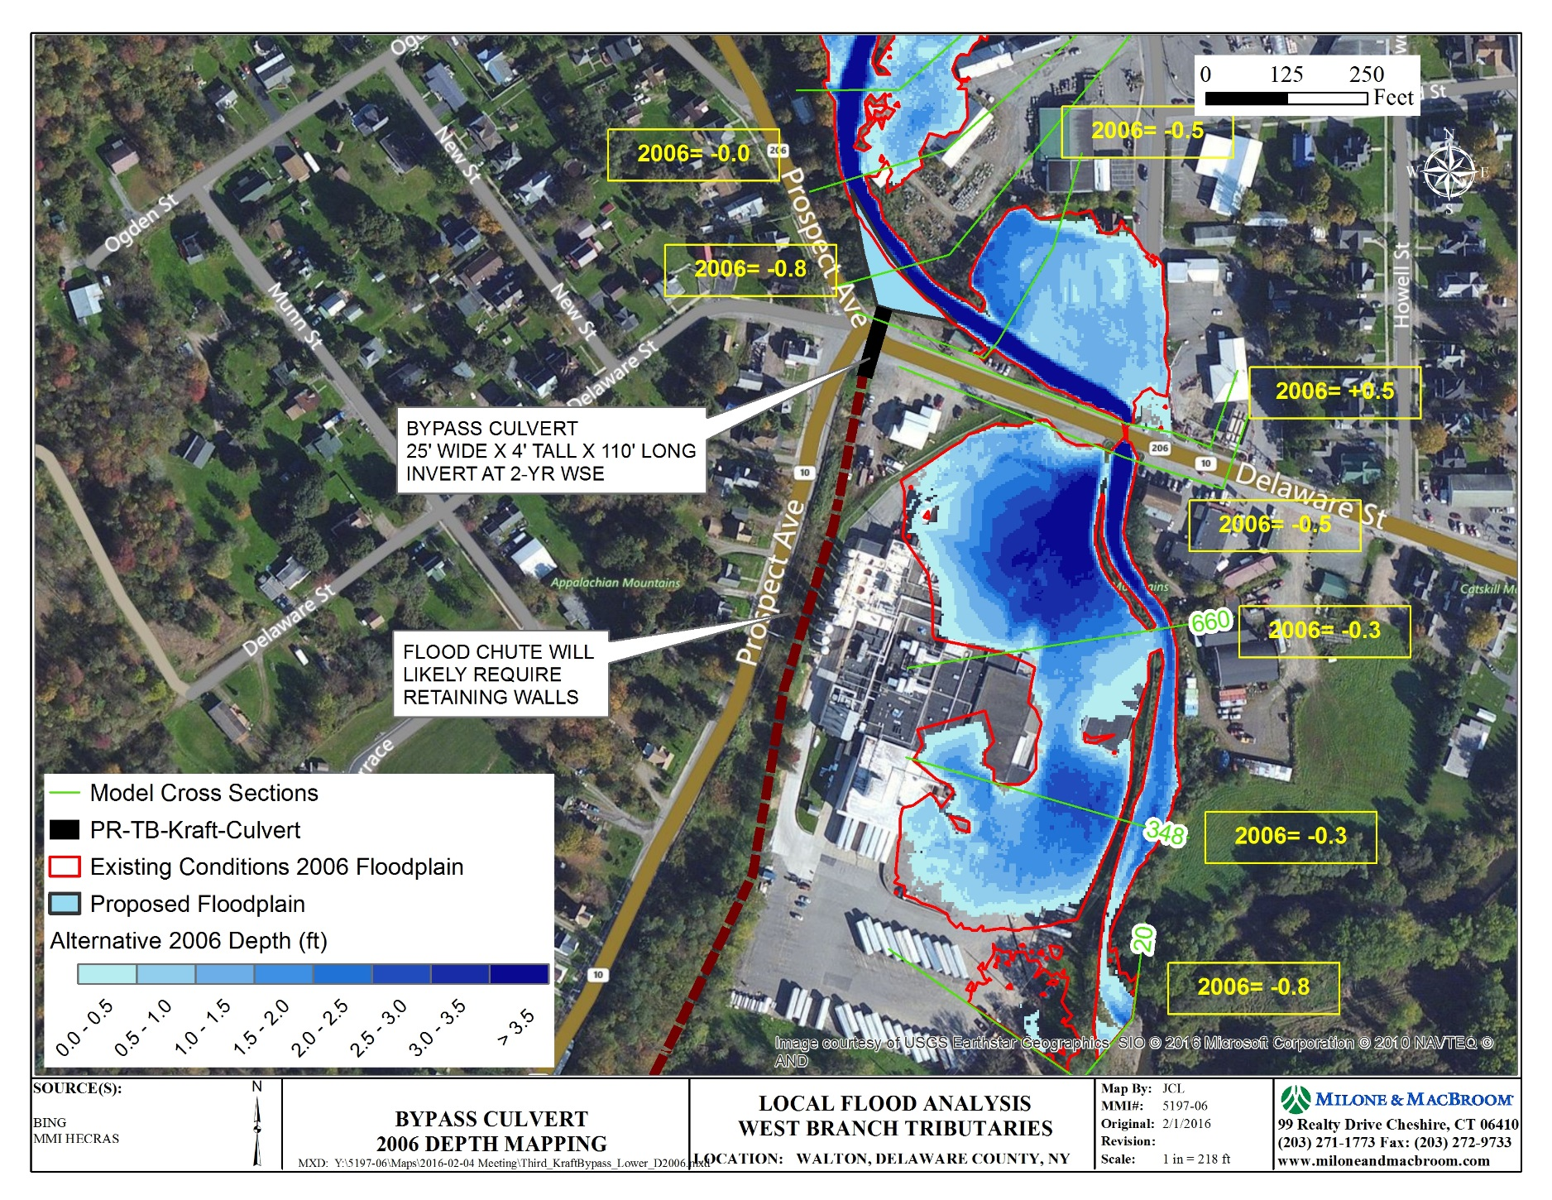
Bypass Culvert at Kraft – 2006 Flood

