Slide 1
Town of Walton
Reassessment 2017
Public Information
Feb 2016
Joseph H. Emminger
John Zukowski
Emminger, Newton, Pigeon & Magyar, Inc.
Mark E. Jacobs, Assessor

Slide 2
Reassessment
Does Not
Raise Tax Levies
*** Reassessment provides an equitable redistribution of the property tax. ***
Now we will show you how.

Slide 3
New York State
Assessment Standard
What the Law Requires!!!
The "Assessment Standard" (RPTL 305): "all real property in each assessing unit shall be assessed at a uniform percentage of value“.
The assessor signs an oath to this effect when signing the tentative assessment roll every year!
  ”Value" is defined as ”Market Value" - the most probable sale price, in a competitive and open market, between a willing and knowledgeable buyer and seller, made without duress to either party
  Tax bills must display the municipality's uniform percentage and the parcel's market value

Slide 4
Important Facts About Property Reassessment
Increased assessments do not cause increased taxes.
Your tax bill results from the budgets created by the School, Town and County. Your assessment may have not changed for many years, yet your property tax has increased- this is due to increased budgets.

Slide 5
Goal of the Project
The goal of the reassessment project, as
you may know, is to establish uniform, fair
and equitable assessments.

Slide 6
Town of Walton
Reassessment Project Timeline
April 2016 – February 2017
Field Activities:
- Site Inspection
- Digital Photos
Valuation Activities:
- Sales verification and analysis
- Valuation testing
- Field review of predicted values
- Finalize tentative assessments
February-April 2017
Public Informational Meetings
- Assessment Appeal process

Slide 7
Town of Walton
Reassessment Project Timeline
February/March, 2017
Mail Assessment Full Disclosure Notice
March - April 2017
Informal Assessment hearings
May 1, 2017 File Tentative Assessment Roll
May 2016 Board of Assessment Review (Grievance Day)
New Assessments will be used:
September 2017 School Tax Bills
January 2018 Town & County Tax Bills

Slide 8
Frequently Asked Questions
F.A.Q.s
Why is my community doing a reassessment project?
Taxes are a zero-sum game–What one property owner doesn’t pay will be picked up by someone else. So, if one property or one neighborhood is significantly under assessed, not only are they paying too little in taxes but other property owners are subsidizing that taxpayer or neighborhood’s share of the bill.

Slide 9
Advantages of a Stable Property Tax Base Through Reassessment
Improved Bond Rating – Bonding companies such as Moody’s and Standard & Poor recognize the fiscal advantage of a stable property tax base in rate policy.
Equity – property owners receive fair and equal treatment when all properties are assessed at a uniform level.
Corrects Inequities-Taxes do not go up as a result of reassessment itself–those who were unfairly paying too much will pay less, and those who are unfairly pay too little will pay more. Reassessment really merely corrects the inequities, with no net tax increase reassessment is a zero-sum game.

Slide 10
Advantages of a Stable Property Tax Base Through Reassessment
Overall taxes do not increase–merely raising the assessed value of market value, by itself, does not raise individual owners taxes. Your taxes increase only if you were previously under assessed ( and, therefore, paying too little in taxes). For each property owner that sees an increase in taxes, someone else will see their taxes come down.
Reassessment does not help or hurt a particular group. e.g., older residents or poorer neighborhoods–it all depends on whether the individual’s property was undervalued or overvalued beforehand. The fact, typical reassessment will help homes and neighborhoods that have not appreciated as fast as the rest of the community.

Slide 11
Pitfalls of Not Maintaining Assessment Equity
Lack of Transparency– the lack of reassessment does not keep taxes from going up. However, the lack of reassessment does over–tax some property owners, who end up subsidizing others were paying too little. This is anything but transparent and very difficult for taxpayers to understand.
Outdated Assessed Values– in this creates an inequity in the role.
Lack of Taxpayer Understanding- various misconceptions about reassessment all comes down to a lack of understanding of about a very technical subject. Unfair and outdated assessments confused taxpayers regarding market values equalization rates. In a non-reassessment community, taxpayers with appreciating properties pay less than their fair share of taxes, and the benefit is paid for by the taxpayers whose property values have not appreciated.

Slide 12
Pitfalls of Not Maintaining Assessment Equity
Fluctuating Equalization Rate– in non-reassessment municipalities, rates will change each year as the overall market value changes, causing a shift in the county and school portion. Taxpayers also do not understand why there “ Full Market Value” as stated on their tax bills has changed, when their assessments have remain the same.
Exemptions– Fixed dollar exemption amounts that are dependent upon equalization rates (such as the Alternate Veterans Exemption) will drop as the rate drop. This increases the overall taxable portion of your assessment, resulting in higher taxes.

Slide 13
Frequently Asked Questions
F.A.Q.s
If my town does a reassessment, will my taxes increase?
A reassessment does not necessarily mean that your tax assessment or your taxes will increase. Furthermore if your assessment does increase, it does not necessarily mean your taxes will increase.

Slide 14
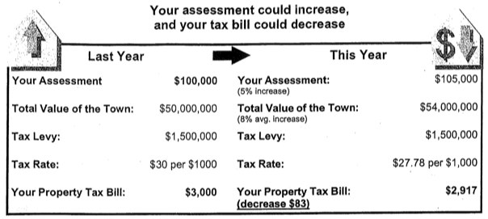
Assessments Vs. Taxes
What’s the difference

Slide 15
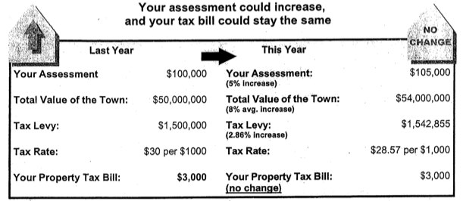
Assessments Vs. Taxes
What’s the difference

Slide 16
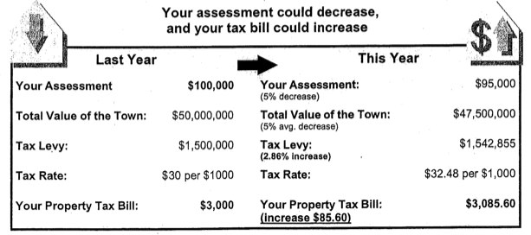
Assessments Vs. Taxes
What’s the difference

Slide 17
Frequently Asked Questions
F.A.Q.s
Will my school district received less state aid after the reassessment?
No. The state aid to public education formula developed by the state legislator uses a variety factors to determine the amount of state aid school district will receive each year. The measure of real property wealth is not based on local assessments but rather determined by the state for each school district.

Slide 18
Frequently Asked Questions
F.A.Q.s
Does New York State require reassessments?
New York states real property tax law addresses the issue of assessment equity. While it does not require assessments to be 100% of market value, it does establish a standard assessments be fair and uniform percentage of market value.

Slide 19
Frequently Asked Questions
F.A.Q.s
Who is responsible for assessments and who is responsible for taxes?
Assessments are determined by the assessor, who independently estimates the market value of real property in your community. Market value is how much a property would sell for under normal conditions.
Your taxing jurisdiction school district, town, county etc. is responsible for developing and adopting the budget. The budget process looks at the amount of money needed to run the town, county, school district, etc. and the available revenue sources. The tax levy is the portion of the budget raised by property tax.

Slide 20
Frequently Asked Questions
F.A.Q.s
What is the difference between market value and assessment of my property?
The market value of your property is generally defined as what the property would sell for under normal conditions.
Assessments in the Town of Walton are approximately 25.90% of market value. The last town wide revaluation was done in 1971. Why is this important.

Slide 21
Frequently Asked Questions
F.A.Q.s
How does the Assessor decide which assessments to change and by how much?
In some cases, where assessments do need to be changed, your assessor will be able to increase or decrease the assessments of the neighborhood or group properties by applying real estate market trends to those properties.
In other cases, the assessor will need to conduct physical re-inspections for reappraisals of each property.

Slide 22
Frequently Asked Questions
F.A.Q.s
How can I check the accuracy of the information the Assessor has on my property?
You can go to the Town of Walton website to access and verify the assessors office information. Or you can talk to the assessor, or their representative.
http://townofwalton.org (we will show you how?)

Slide 23
Frequently Asked Questions
F.A.Q.s
If my home is physically re-inspected, do I have to let the Assessor in?
While you are not required to let the assessor or data collector in your home, your cooperation, along with that of all other property owners in your community, helps assure that your assessment will be fair and based on complete and accurate information.

Slide 24
Frequently Asked Questions
F.A.Q.s
When will I know my new assessment?
Based on the available information about your property, your Assessor will estimate the market value of your property. If a change is necessary a notice than will be sent to you informing you of your new assessment.

Slide 25
Frequently Asked Questions
F.A.Q.s
What if I disagree with the assessment on the tentative role?
More information about the assessment review process, including application deadlines and instructions, can be found in “What To Do If You Disagree With Your Assessment”
www.tax.ny.gov/pit/property/contest/contestasmt.htm

Slide 26
Reassessment
Does Not
Raise Tax Levies
*** Reassessment provides an equitable redistribution of the property tax. ***
QUESTIONS??

Slide 27
THANK YOU!
ENPM, INC.
Joe Emminger
716-685-0500 ext 12

